Slide 1
SUBMITTED BY:
PARTICIPANT 01: SRISTI MITRA
ROLL: 2K19/CO/389 (A6)
PARTICIPANT 02: ZISHNENDU SARKER
ROLL: 2K19/CO/450 (A6)
STUDENT DATABASE MANAGEMENT SYSTEM AND
PREDICTION OF RESULTS USING DATA MINING
SUBMITTED TO:
MANOJ SETHI
DATABASE MANAGEMENT SYSTEM

Slide 2
INTRODUCTION
Student Management system can handle all the detail about a student.The details include college details, Students personal details, Academic details etc.
•The student management system is an automated version of manual Student Management System.
•It includes process like registration of the student's details, assigning the department based on their course and maintenance of the record.
Data mining is also used for discovering patterns from a certain dataset and showing test results by going through their academic and institutional records.
COOL

Slide 3
PROBLEM STATEMENT
WE HAVE TO IDENTIFY ANY PROBLEM BEFORE SOLVING IT
•Problems occurred before having computerized system includes:
File lost:
When computerized system is not implemented file is always lost because of human environment. due to some human error there may be a loss of records.
File damaged:
When a computerized system is not there file is always lost due to some accident like of water by some member on file accidentally. Besides some natural disaster like floods or fires may also damage the files.
Students does not get fruitful results back from their institution because of lack of time and scope to see all the students one by one and find out their flaws. It is not always possible to predict how much a student may score from their institutional records and behaviors. So, the school system does not become beneficial for the students.

Slide 4
OBJECTIVE!
•Student Management system is a management information system for education establishments to manage student data.
•It provide capabilities for registering students in courses,Admitting students, tracking student and Submitting students documents online.
•Ensure data integrity, privacy, and security in an open-access environment.
•We are planning to utilize the powerful database management, data retrieval and data manipulation. We will provide more ease for managing the data than manually maintaining in the documents. Our work is useful for saving valuable time and reduces the huge paperwork.
• Predicting a student database management system for the future result of particular or group of students based on their academic records , by using J48 algorithm through data mining .

Slide 5
TOOLS AND PLATFORM?
SOFTWARE AND HARDWARE REQUIREMENTS!
For saving the data of students we have used mysql database.
•It needs Most recent version of Google Chrome, Firefox, Internet Explorer, or safari.
•Hardware Requirement: –
CPU: Single Core 2.4 GHZ RAM: 512 MB
Graphics Card: Intel or Nvidia
Hard Drive: 5 Gigabytes
Network: Broadband Recommended –
Processor: Pentium
•Operating System: Window(XP, Vista, 7, 8, 10), Mac OS, Linux, Unix.
•Internet Connection with good speed.
We have used PHP , HTML, CSS and javascript
The entire website executes on the XAMPP server.
To Access the website we can use any type of web browser.

Slide 6
MODULE
ADMIN:
REGISTRATION ( LOGIN )
ADD COURSE
ADD SUBJECT
VIEW AND MODIFY STUDENTS INFORMATION
VIEW AND MODIFY SESSIONS

Slide 7
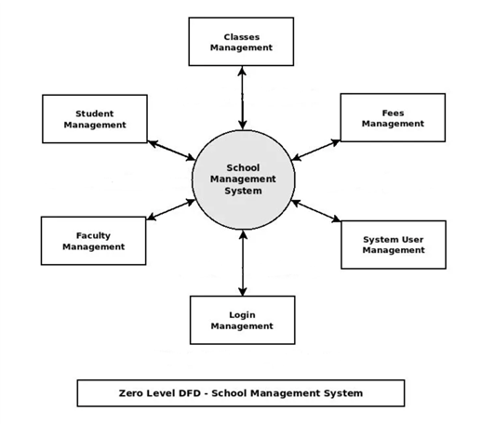
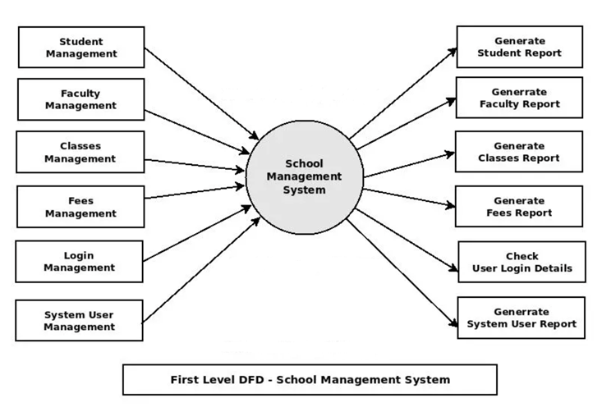
DATA FLOW DIAGRAM
Notes:
A Data Flow Diagram (DFD) is a traditional way to visualize the information flows within a system. It shows how information enters and leaves the system, what changes the information and where information is stored.

Slide 8
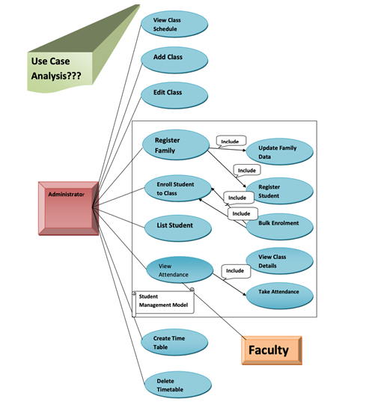
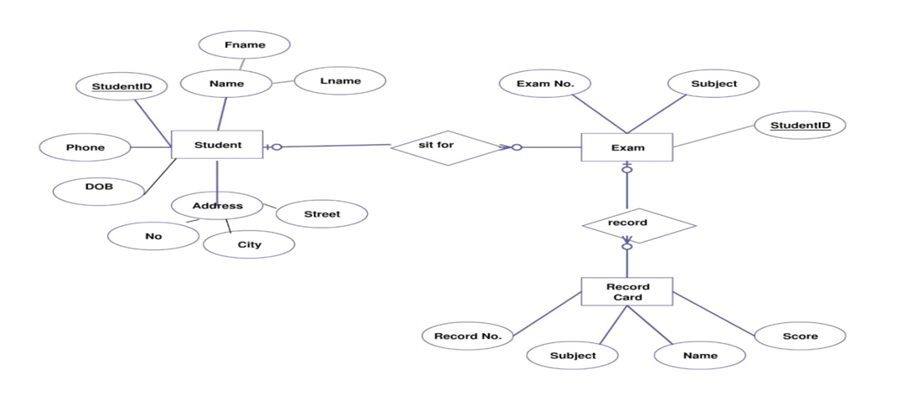
USE CASE DIAGRAM:
ER DIAGRAM :

Slide 9
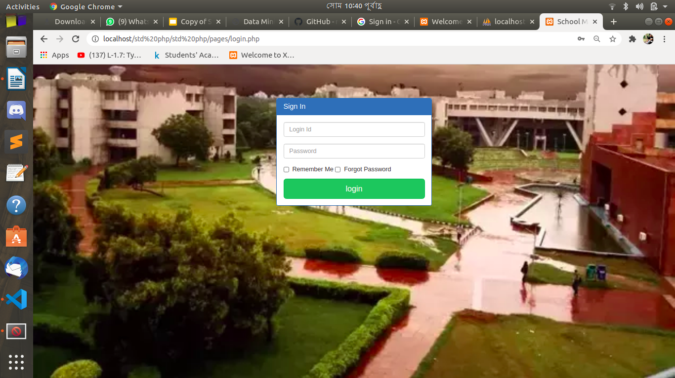
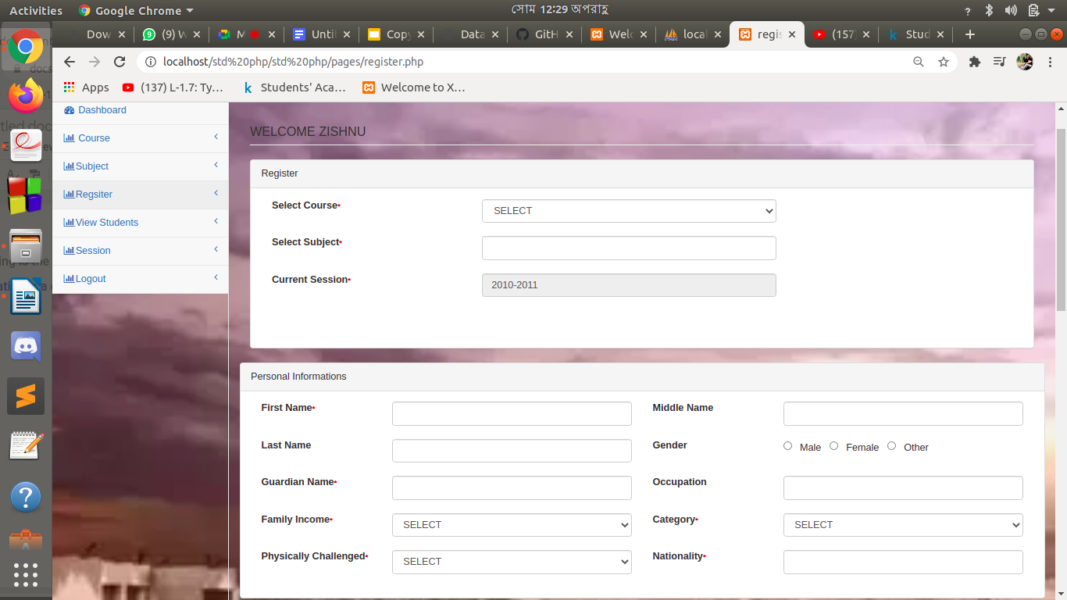
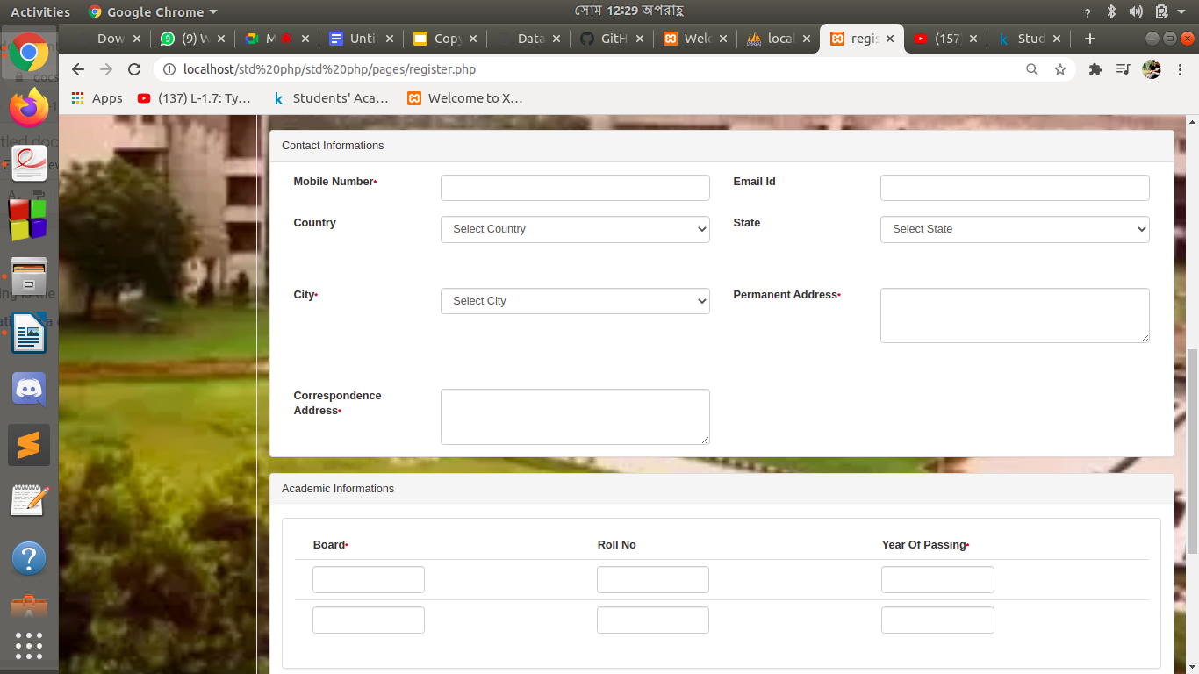
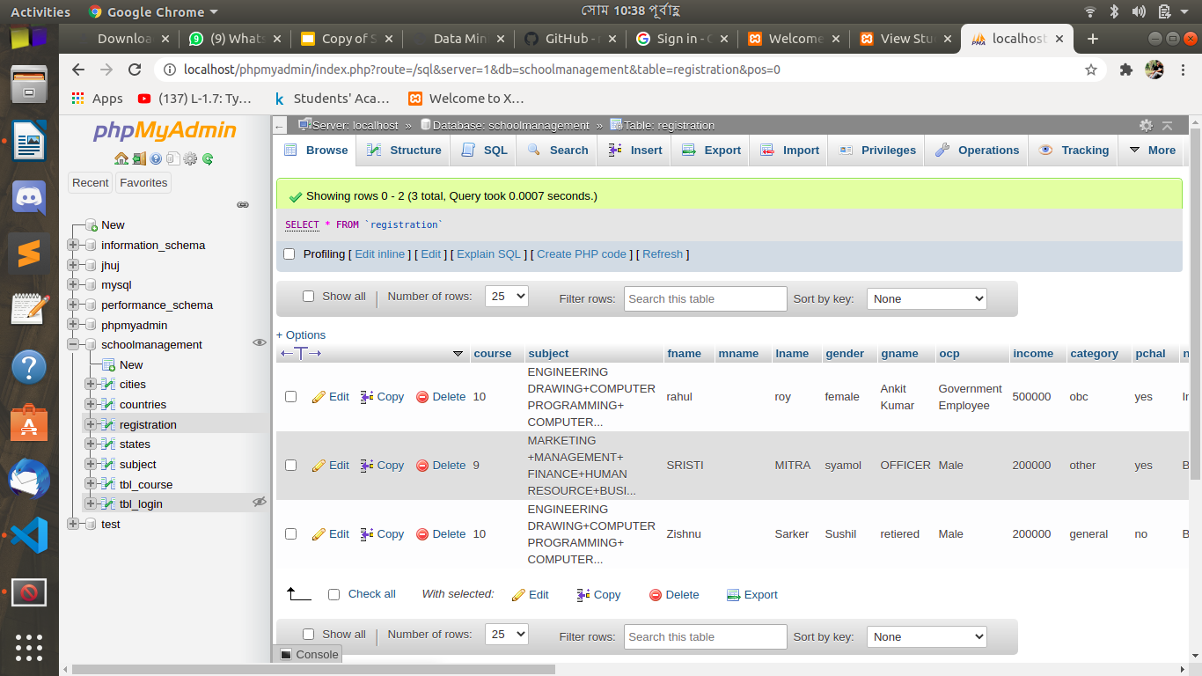
Project Screenshot :

Slide 10
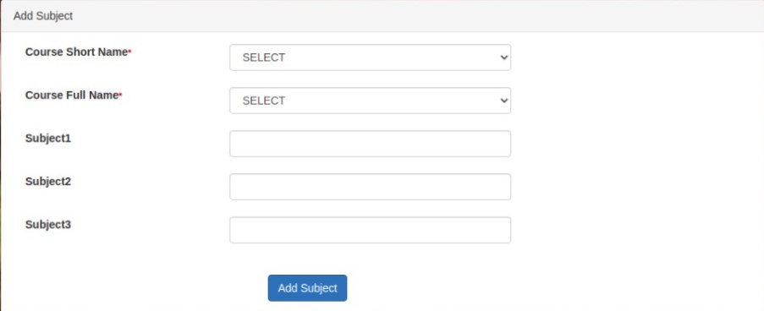
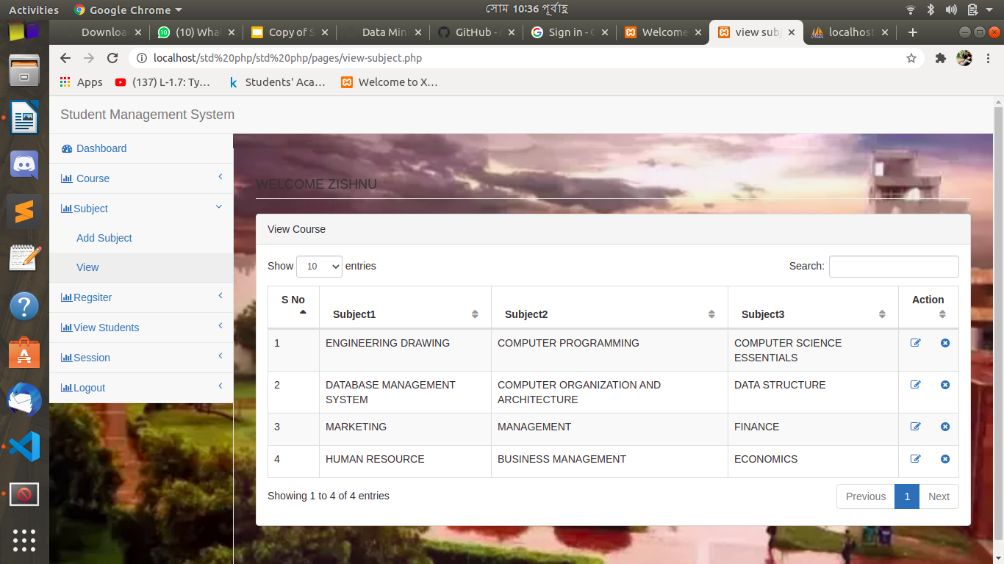
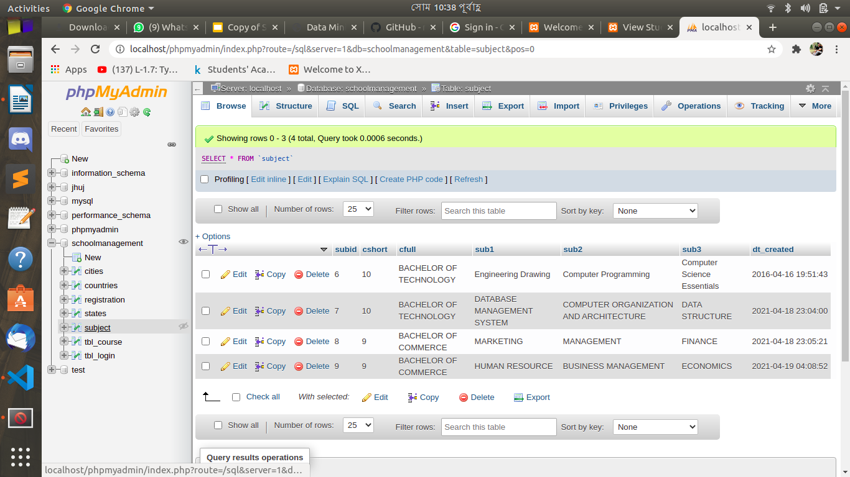
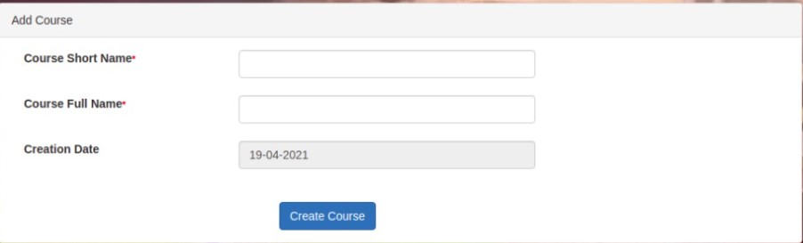
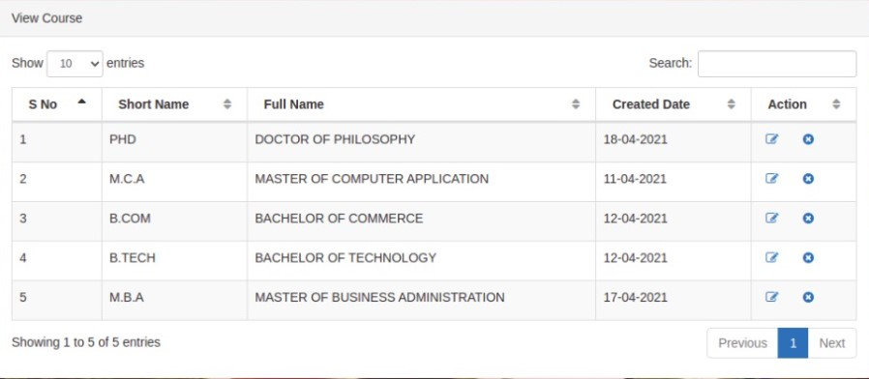
Project Screenshot :

Slide 11
Measuring uniqueness :
DATA MINING:
Data mining is the process of analyzing data in different angles and summarizing results it into useful information. We can also say that data mining is the process of finding correlations among many numbers of fields in a huge dataset. The major role of data mining is applying various procedures and algorithms in order to retrieve patterns from huge data.
Informally, it's the process of using a computer program to find patterns or relationships in data i.e. discovering patterns.
The major objective of this work is to use data mining methodologies to analyze student’s test results based on their academic performance. Data mining provides many tasks that could be used to analyze the performance of the student. In this research, the classification is used to predict the student test result based on their academic performance. As there are many algorithms are used for data classification, in this
paper the decision tree method is used for classification.
We are ultimately going to consider 3 different types of machine learning:
Classification Learning
Association Learning
Numeric Learning

Slide 12
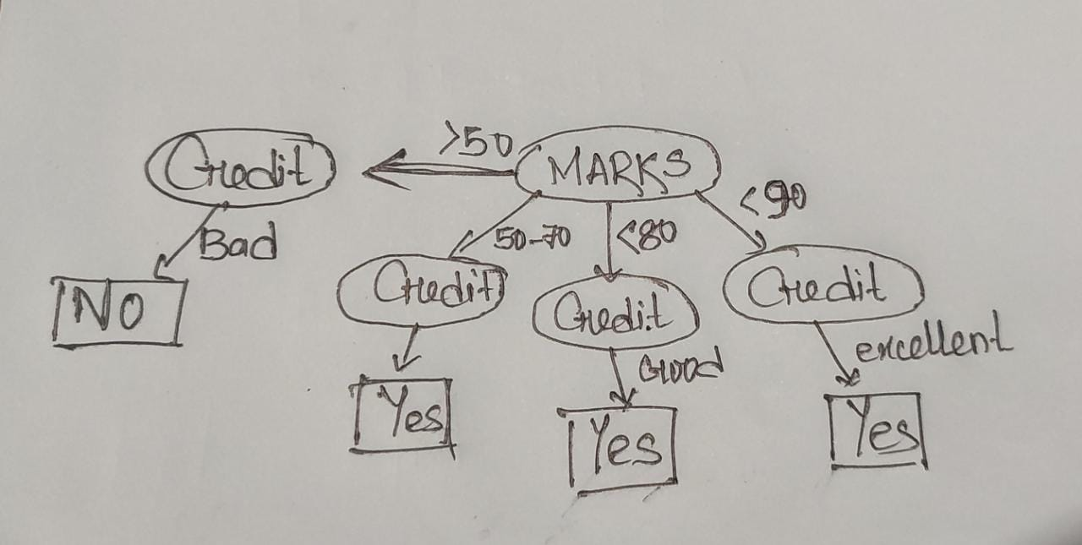
Measuring uniqueness :
CLASSIFICATION:
DECISION TREE MODEL:
Classification is a data mining technique that assigns items in a collection to target categories . The objective of classification is to accurately predict the category which is unknown for each case in the data. For example, a classification model could be used to identify student results as pass, good, very good or excellent. A classification task begins with a data set with known class labels. For example, a classification model which predicts student results might be developed based on observed data for students academic performance over a period of time.
Decision tree models can be implemented in either serial or parallel form or in both serial and parallel form. Parallel implementation of decision tree algorithms is very useful in quickly generating results especially with the classification a huge data. When small or medium data sets are involved, serial implementation of decision tree algorithm will be used. The major objective of this work is to use data mining methodologies to analyze student’s job-position based on their academic performance. Data mining provides many tasks that could be used to analyze the performance of the student.
student_name | Marks | Credit | Good Results?
zishnu | 90 | Excellent | Yes
sristi | 82 | Good | Yes
Pooja | 65 | Fair | Yes
Ratri | 45 | bad | No

Slide 13
J48 ALGORITHM USED:
The J48 algorithm is used to implement Univariate Decision Tree approach, while its results are discussed.
WEKA - an open source software provides tools for data preprocessing, implementation of several Machine Learning algorithms, and visualization tools so that you can develop machine learning techniques and apply them to real-world data mining problems
Weka allow the generation of the visual version of the decision tree for the J48 algorithm. So, from the “Classifier” section select “trees” > “J4.8”. Also make sure that the “-C 0.25 -M 1” options are selected for the algorithm
Decision rules will be found based on entropy and information gain ratio pair of each feature. In each level of decision tree, the feature having the maximum gain ratio will be the decision rule
PROCESS OF WEKA IMPLEMENTATION:
We need to load Dataset into Weka.
We choose classifier according to need.
Select the attribute we want to work
Go to result and switch it view the decision tree.

Slide 14
J48 ALGORITHM PROCEDURAL THEORY IN WEKA:
The dataset for a classification algorithm is divided into two data sets: 1.Training set is the one for building the model 2. Test set is the one for testing the model
Model is built using the training set using the J48 algorithm. The objective of the work is to apply the model for the test dataset and to find the performance of the model by classifying the new instance. This model is generated for obtaining the student job position based on their academic performance. If the performance of the model is acceptable this model may be used for the forthcoming graduates to analyze the placement status.
The model to classify the instances of the sample training set which is provided in format is ARFF (studentdata.arff)
WEKA source file which will then include academic year, department etc.
The attribute section is identical to the training data.
Once the model is generated, it can be used to classify new instances. Here classification is used to classify new instance using J48 algorithm which is implemented in WEKA by the classifier
The classification model generation process using studentdata.arff in WEKA
The running information of model generation is generated
For which The graphical versions of the decision tree are appeared
Though there are a lot of attributes in student dbms but For this analysis the relevant attributes such as academic year, department of the graduate, final academic results and job- position of the graduate only used
Once the model is generated, the details of the model such as total number of instance in the dataset, the number of correctly classified instance, incorrectly classified instance, and accuracy of the model will be displayed

Slide 15
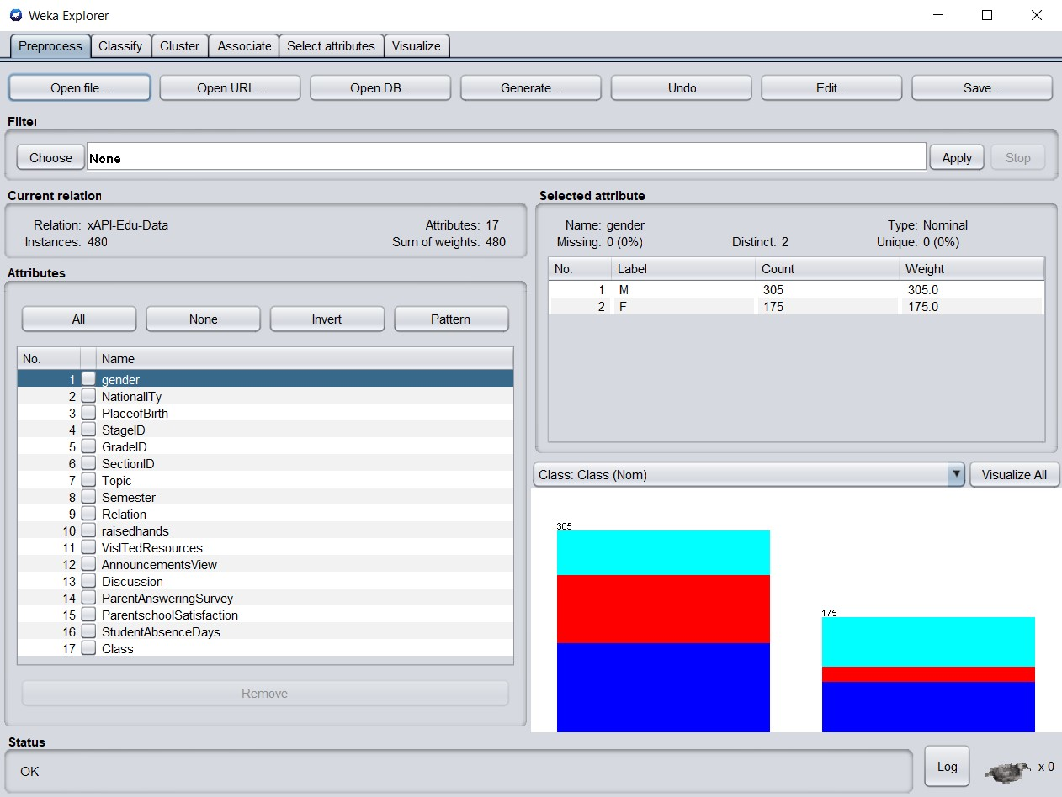
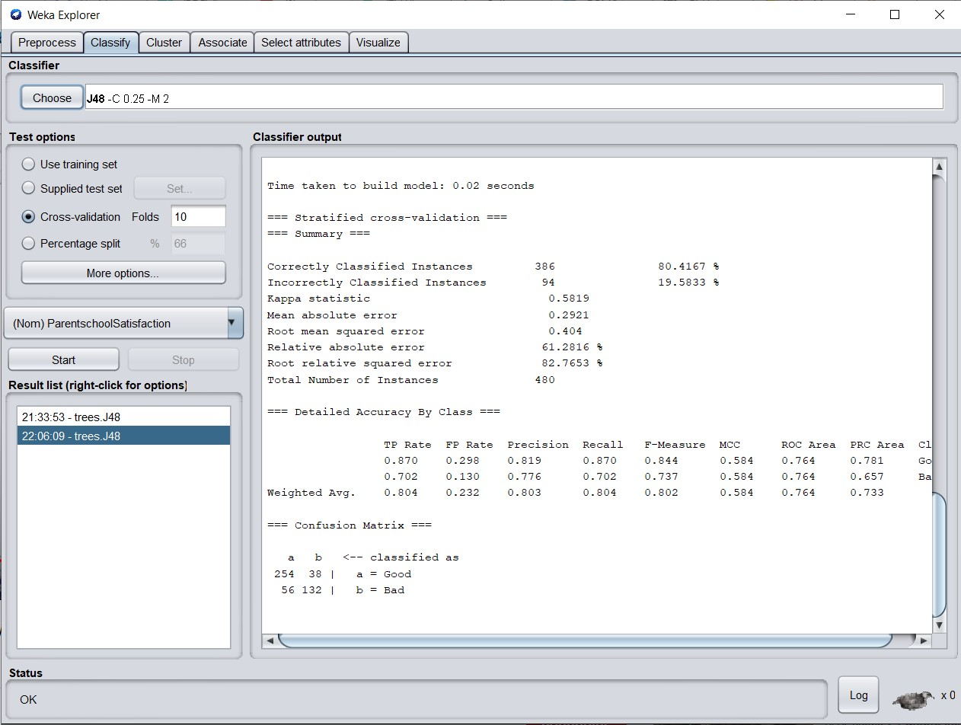
IMPLEMENTATION OF J48 ALGORITHM IN WEKA:
Here, we import the dataset in Weka and it shows the current relations, instances and attributes.
Here, we are choosing the classifier to J48 algorithm

Slide 16
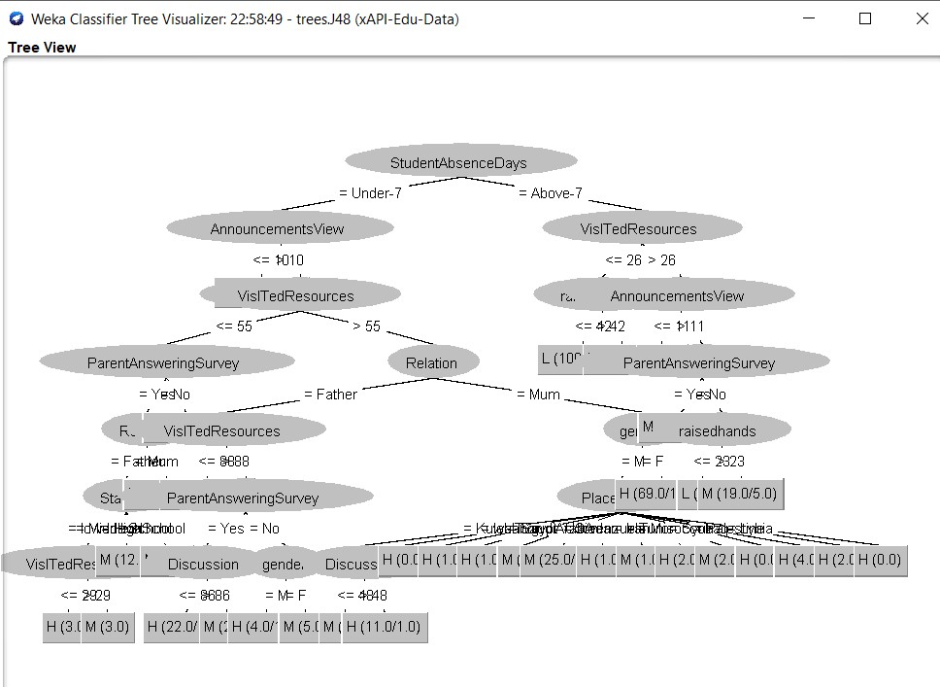
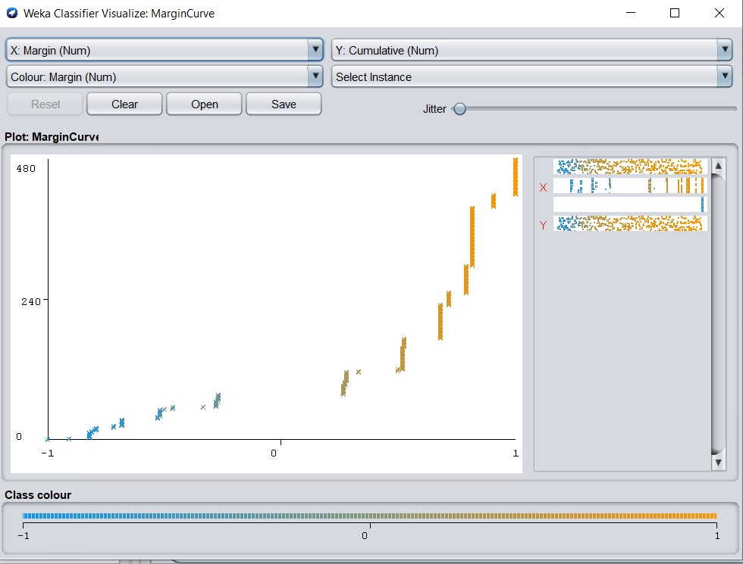
Here is the decision tree view of the dataset imported.
Here shows the marginal curve of the dataset

Slide 17

FUTURE SCOPE:
We will include more functionality as per the user requirements.
We want to improved our home page, as it is the main thing which attracts all user
Not a single website is ever consider as complete forever firstly because there is always something new requirement also are growing day by day.

Slide 18
REFERENCES
1. Wisdom Kwami Takramah, Wisdom Kwasi Atiwoto. Student Database System for Higher Education: A Case Study at School of Public Health, University of Ghana. American Journal of Software Engineering and Applications. Vol. 4, No. 2, 2015, pp. 23-34.
2. Vivienne V. Forrester. School Management Information System: Challenges To Educational Decision- Making In The Big Data Era. International Journal on Integrating Technology in Education (IJITE) Vol.8, No.1, March 2019.
3. Shakeel Ahmad Dar. Development of a Student Database Management System for Polytechnic sector. International Journal of Advance Engineering and Research Development. Vol 5, Issue 01, Jan -2018
4. Mohammad Kamalal-Din Abbas.”Students Fingerprint Attendance System for Faculty of Engineering using PHP & SQL” . Dept. EEE, University of Khartoum, Khartoum,Sudan, 2009. “https://projectabstracts.com/20661/students-fingerprint-attendance-system-for-faculty-of-engineering-using-php-sql.html”
5. Bassil, Youssef. "A Data Warehouse Design for A Typical University Information System." arXiv preprint arXiv:1212.2071 (2012).
6.Yu, Chong Ho, et al. "A data mining approach for identifying predictors of student retention from sophomore to junior year." Journal of Data Science 8.2 (2010): 307-325.

Slide 19
THANKS!
SRISTI MITRA (2K19/CO/389)
&
ZISHNENDU SARKER (2K19/CO/450)
ANY QUESTIONS?

